Slide 1
CYCLIST BIKE-SHARE
Data analytics approach
[Marketing analyst team] - [Manager-Lily Moreno], [ Junior Data Analyst-Pratik Salgaonkar]

Slide 2
Agenda
Introduction to Cyclist program and problem we trying to solve.
Data insights
Summary
Strategy

Slide 3
Introduction
Cyclistic is a bike-share program that features more than 5,800 bicycles and 600 docking stations. Cyclistic sets itself apart by also offering reclining bikes, hand tricycles, and cargo bikes, making bike-share more inclusive to people with disabilities and riders who can’t use a standard two-wheeled bike. The majority of riders opt for traditional bikes; about 8% of riders use the assistive options. Cyclistic users are more likely to ride for leisure, but about 30% use them to commute to work each day. There are two types of riders or members in this bike sharing program which are Casual riders and Annual members, Customers who purchase single-ride or full-day passes are referred to as casual riders. Customers who purchase annual memberships are Cyclistic members. This analysis is perform to find out how differently the casual members have used the bikes than annual members in past 12 months? & how can we convert casual members into annual members?

Slide 4
Data Insights

Slide 5
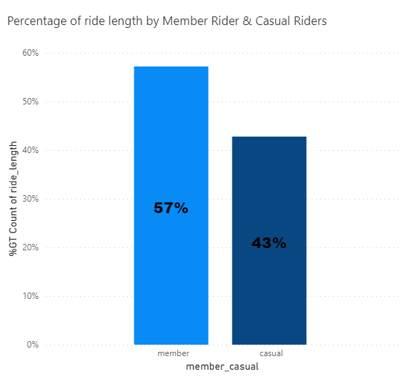
Data Insights
Ride length comparison between the causals vs annual members.
While analysing we have found that the annual member uses the bikes to ride more often than the casual members .
In the next bar chart we can see that the ride length of the annual members is very high which is 57% of total ride length in past 12 months as compared to the casual members which is 43%.
Place any supporting images, graphs, data or extra text here.

Slide 6
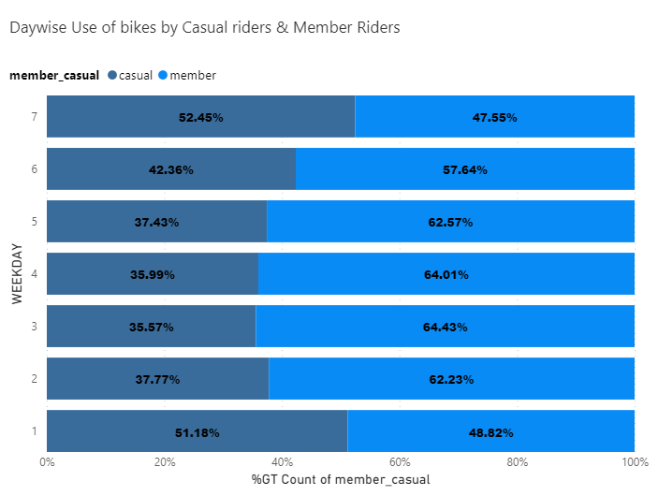
Data Insights
Everyday use of bikes between the causals vs annual members.
When it comes to everyday use of bikes we can see in the chart that the casual members tend to use bike more on weekends.
Whereas the annual members use bike more on weekdays most of them use it to commute to work each day.
Place any supporting images, graphs, data or extra text here.

Slide 7
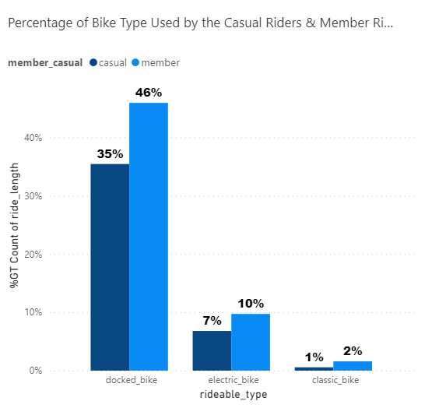
Data Insights
Type of bike use between the causals vs annual members.
With the next chart we can see that both casual and annual members use the docked bike the most which is 35% and 46% respectively.
When it comes to electric bike it is 7% and 10%
And for classic bike it is 1% and 2%.

Slide 8
Summary

Slide 9
Summary
The Cyclistic’s finance analysts have concluded that annual members are much more profitable than casual riders also the director of marketing believes that there is a very good chance to convert casual riders into annual members
From the analysis it has been found that the casual members uses the bikes very less as compared to the annual members, they use the bikes mostly on weekends. There ride length is shorter than the Annual members. Both the members uses the docked bike mostly as compared to the other ride options. casual riders are already aware of the Cyclistic program and have chosen Cyclistic for their mobility needs. To convert the casual riders to annual members we need to introduce new payment or pricing strategies and attractive offers which will appeal or motivate the casual riders to go for annual membership program.

Slide 10
Strategy

Slide 11
Strategy
Target Customer = Casual Member.
Goal = To convert casual members into Annual member.
How = By creating awareness about cyclistic program’s new offers about Annual membership to existing causal members.

Slide 12
Currant Strategy
Pricing Flexibility – Single ride passes, Full – day passes, Annual Membership.
Building General awareness about Cyclistic Program.

Slide 13
New Strategy
Developing New pricing model and exciting offers for existing casual members like discount on Annual membership, free ride once in a month for new annual members.
Building awareness among existing casual members about new payment schemes and exciting offers available for Annual membership with the help of digital media like Social Media marketing, E-Mail marketing etc.
Furthermore even if they refuse to go for annual membership we should receive the feedback from casual riders about the whole Cyclistic program and the things which are stopping them from getting an annual membership so that we can design much better strategy.

Slide 14
Thank You

Slide 15
Appendix

